Slide 1
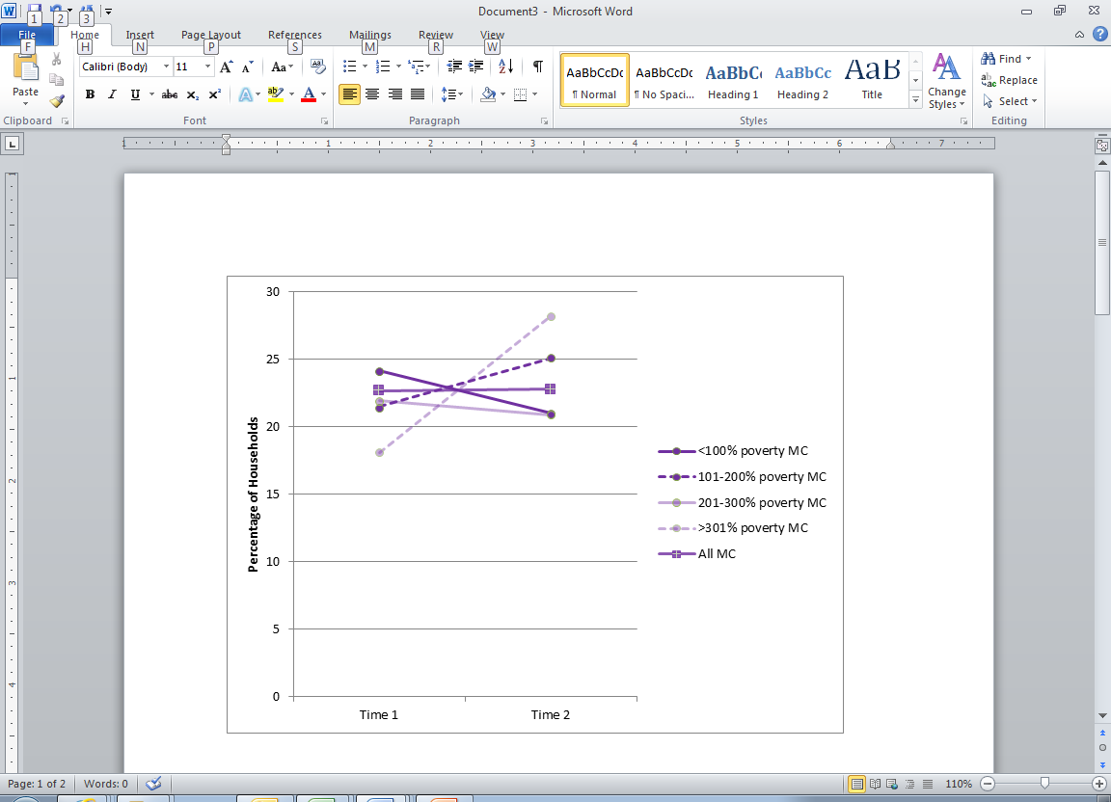
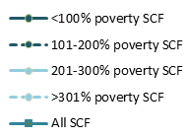
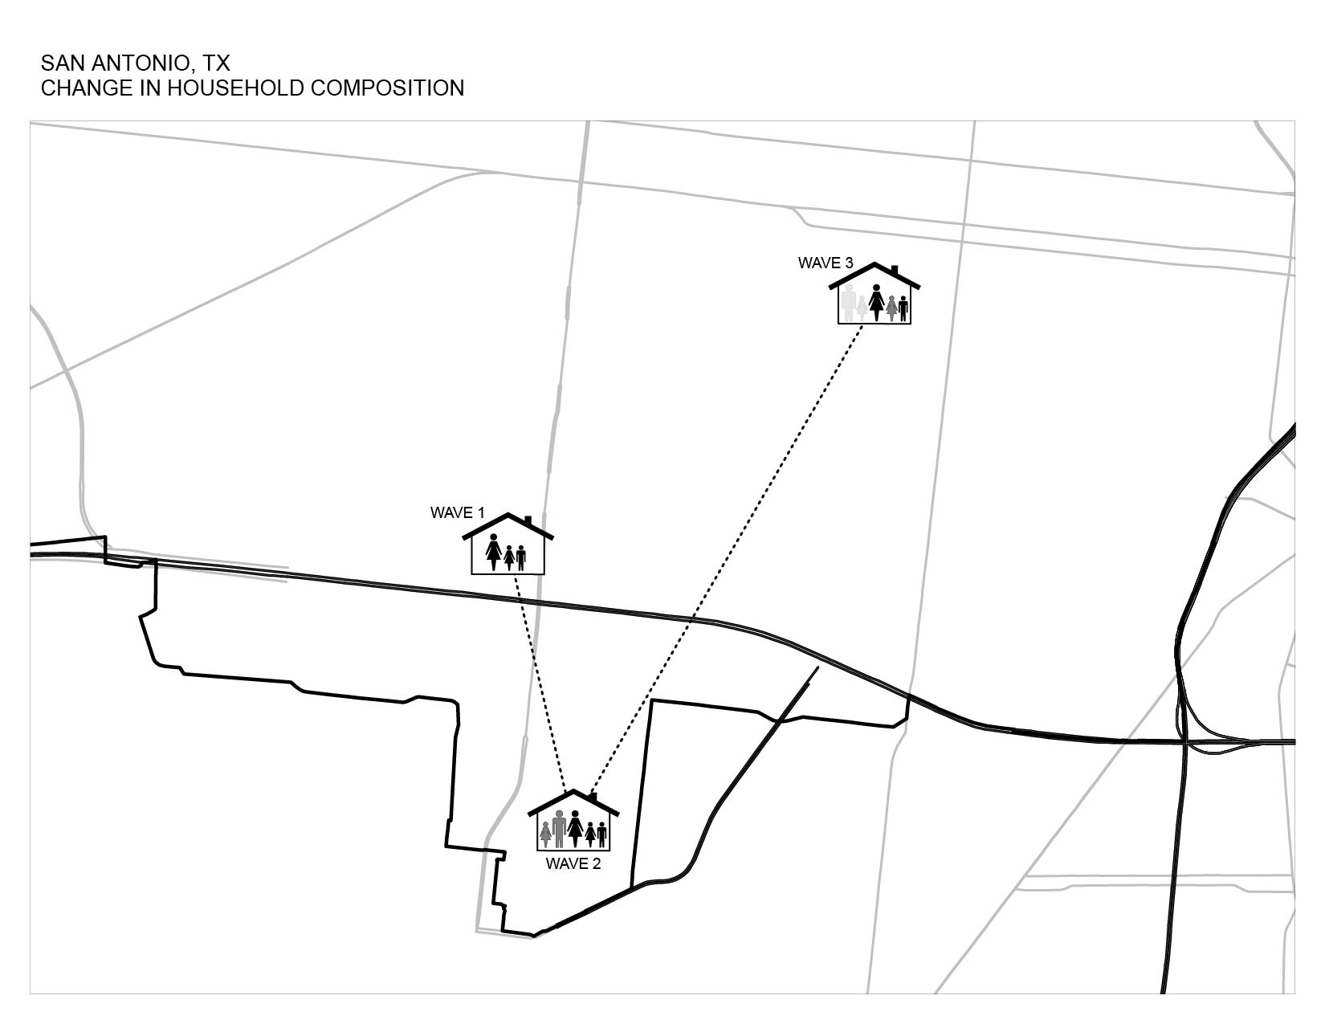
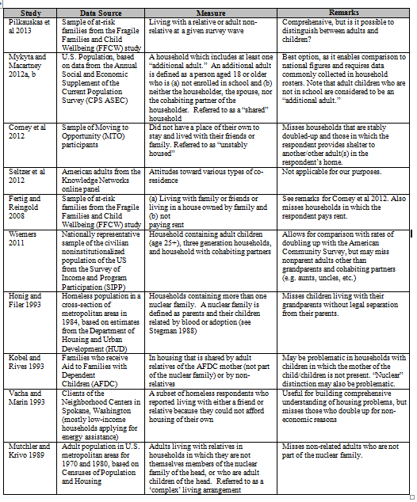
Identifying Doubled-Up Households using Survey Data
Kate Bachtell and Catherine Haggerty | bachtell-kate@norc.org
ABSTRACT
DATA
SUBSTANTIVE APPLICATION
The U.S. Census Bureau has reported a significant increase in the number of doubled-up households following the 2007 economic recession, including a 2% growth in the proportion of young adults ages 24 to 35 living in their parents’ homes between 2007 and 2009. These households are defined as those including at least one non-student adult who is not the householder or the householder’s partner (DeNavas-Walt et al 2011). In 2011 18.3% of U.S. households were doubled up - an increase of 1.3% since the height of the housing market boom in 2007. These data have inspired many studies examining doubling up as a strategy for making ends meet during times of financial hardship. Analysts are often challenged to identify doubled-up households using household roster data, without the benefit of contextual information about life cycle events (marriage, new births, etc.) and despite the temporary nature of many doubled-up housing arrangements. Data limitations may confound efforts to create a measurement of doubling up that captures substitutions of individual household members and other complexities. In this paper we present findings from a small meta-analysis of techniques used to isolate doubled-up households with survey information. We describe our experiences working retroactively with longitudinal data from the Survey of Consumer Finances and Making Connections Survey and offer recommendations for data analysis.
Source Datasets
We used data from two sources: the Making Connections Survey (MC), funded by the Annie E. Casey Foundation, and the Survey of Consumer Finances (SCF), funded by the Board of Governors of the Federal Reserve System. Table 1 below highlights key information about each source.
We tested the application of several doubling up measures using the MC and SCF data. Capturing transitions into doubled up households proved difficult when comparing two different datasets, as shown in Figure 2. For MC, we compared personal identifiers across waves and identified new adults at Time 1 and Time 2. For SCF, the values come directly from a question asking if each adult on the household roster “usually” lived there. These methodological variations may account for some of the stark difference in the rates observed across datasets, with MC families appearing to be more likely than SCF families to have gained adults by a factor of 10 and 4 at Times 1 and 2, respectively.
Table 1. Sources
 | Making Connections Survey | Survey of Consumer Finances
Funding agency | Annie E. Casey Foundation | Board of Governors of the Federal Reserve System
Summary | Neighborhood-based study of families in ten low-income communities across U.S | Preeminent household finance survey in U.S.
Access | Restricted use within NORC's Data Enclave | Public use dataset
Sample type | AP and list of focal children | AP and list, with oversample of high-income Americans
Key advantages | Detailed household roster information and linked personal identifiers | Multiple techniques to provide detailed data on personal and business finances, including dollar probes, range cards, and multiple imputation of missing values
(Figure 2) Capturing Transition into Doubled Up Household Proves Difficult for Comparative Study
The 'newly doubled-up': Presence of one or more adult(s) not previously in the HH among families with children
by poverty level (as of Time 1), weighted
Key for Figures 2-3
Making Connections
Survey of Consumer Finances
THEORETICAL BACKGROUND
Analytical Sample
From MC, we include records from seven sites over two waves, collected between 2005-2007 (“Time 1”), and 2008-2011 (“Time 2”). From the SCF, we use the public-use datasets created with the 2007-2009 panel surveys to represent Time 1 and Time 2, respectively. Our selection criteria for both samples required that 1) the same individual served as the respondent in both interviews, 2) the household size did not exceed 12 members, and 3) one or more children were reported to be living in the household at Time 1. Table 2 provides additional information.
  Why double up?
  Economists use the terms “joint production advantages” (e.g. increased specialization, division of labor, and risk pooling) and “joint consumption advantages” (e.g. shared use of furniture, food, and other household goods) to describe the incentives encouraging individuals to double up. At the same time, doubling up may be viewed as a sign of distress or hardship, and more specifically, as a response to economic constraints which may involve disproportionate use of household resources.
(Figure 1) Example of Transition Into and Out of Doubled Up Household
Table 2. Analytical Sample | Making Connections Survey | Survey of Consumer Finances
Inclusion criteria | Households with children | Households with children
Source for Time 1 | Wave 2, collected 2005-2007 | 2007 SCF
Source for Time 2 | Wave 3, collected 2008-2011 | 2009 re-interviews with 2007 SCF Panel
Figure 3 displays our attempt to replicate the Census Bureau’s methodology using the MC and SCF data. Their approach requires only cross-sectional data, including the age of each household member, his/her relationship to the householder and an indication of school enrollment for each person. Of the studies we reviewed, we contend that the Census definition of shared households presents the best option for identifying and examining doubled-up families.
(Figure 3) Replicating the Census Method: A better approach
Percentage of Shared Households among Families with Children, Weighted
  Our research
  In our past work using data from the Making Connections Survey, a longitudinal study of ten low-income neighborhoods, we found that about 64% (63% and 65% in waves 1-2 and 2-3, respectively) of households with children from the wave 1-2-3 panel moved between waves, and about half experienced a change in household composition (48% and 45% between waves 1-2 and 2-3, respectively) (Bachtell et al 2012, pgs. 107 and 109). Doubling up is not a new strategy for making ends meet among this group of low-income families. Is this rise in doubling up at the national level an example of how poor families may serve as a bellwether for the larger American population after the 2007 recession in their propensity to double up when faced with economic hardship? To investigate this substantive question, we first need to tackle a methodological issue…
Making Connections
Survey of Consumer Finances
FINDINGS
Findings
Measures dependent on “nuclear” family definitions are problematic.
Recent work with longitudinal data focuses on respondents’ co-residence in the homes of friends and family.
Census Bureau’s definitions of “additional adults” - a person aged 18 or older who is (a) not enrolled in school and (b) neither the householder, the spouse, nor the cohabiting partner of the householder - and “shared households” – one which includes at least one “additional adult” - have broad appeal.
  Advantages:
    Enables comparison to national figures
    Can be applied to diverse samples
    Makes few assumptions about economic burden
    Disadvantages:
    Does categorically omit adult students from the pool of potential “additional adults.”
    Requires indication of school enrollment for every person
  In any study, analysts operate within the constraints of their dataset. Particular challenges arise when working with public use datasets, and/or performing comparative analyses.
    We had to make several adjustments to replicate the Census Bureau’s methodology with public SCF data. Examples:
      Due to the age rounding performed by the FRB to prevent the identification of respondents, we define adults as individuals age 20 and older rather than 18 and older.
      Student status was only collected for the respondent and his/her spouse/partner in the SCF, so we could not omit students from the pool of potential “additional” adults.
    Contextual information (e.g. what each person brings to the household) is often lacking.
(Figure 2) Results of Meta-analysis
RESEARCH QUESTIONS AND METHODS
DISCUSSION
Research Questions
RQ1: What are the prevailing measures used to identify and understand doubling up?
RQ2: What are the means of evaluating measures of doubling up?
RQ3: How should we define ‘doubling up’? Consider:
    Sample characteristics
    The presence of non-parent adults
    Transitions to doubled-up arrangements
    Agency: voluntary versus involuntary arrangements
    Methods
Reviewed 10 published studies with original analysis of doubling up
Evaluated measures
Tested applications to the MC and SCF data
Limitations
In the MC sample, the respondent is a primary caretaker of a selected focal child. In the SCF, the respondent is the financial head of the household.
The MC sites included in our analysis are not representative of poor urban communities nationwide
Families in which the focal child chosen at Time 1 aged-out (turned 18 years old) and moved to a new geographic location were not re-interviewed at Time 2 for the MC panel.
In both datasets, there may be unmeasured differences due to sample attrition
  Conclusions
  The best approach = Census definition of ‘shared’ households
  Longitudinal and retrospective cross-sectional data add detail and facilitate in-depth analysis, but cross-sectional relationship data suffice. However:
    Who is the respondent? Is it the head of the household, eldest member, primary caretaker of a focal child, or someone else? This has implications for the identification of doubled up households.
    References
    Available on request.
.

